Slide 1
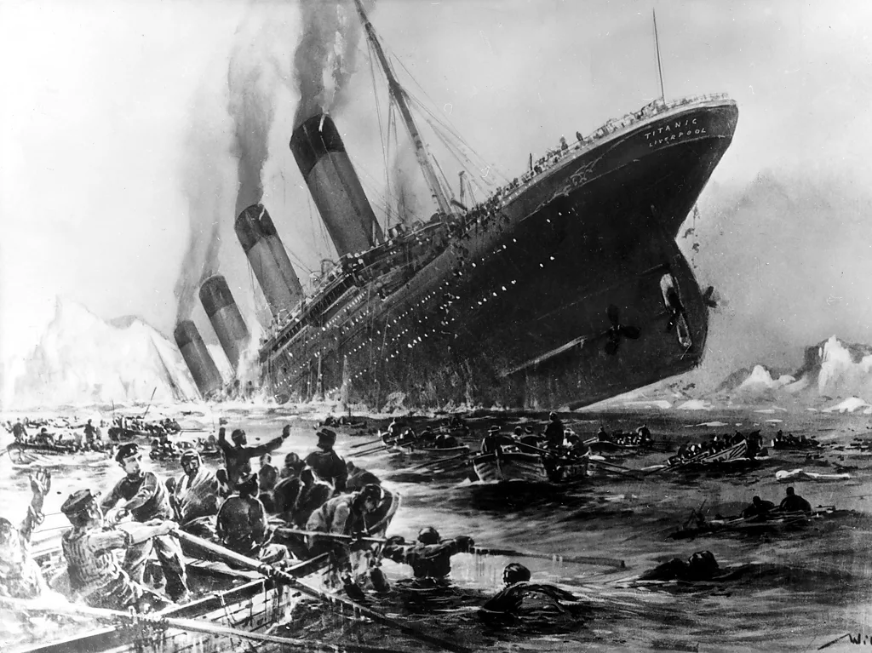
EDA
Exploratory Data Analysis on Titanic Dataset

Slide 2

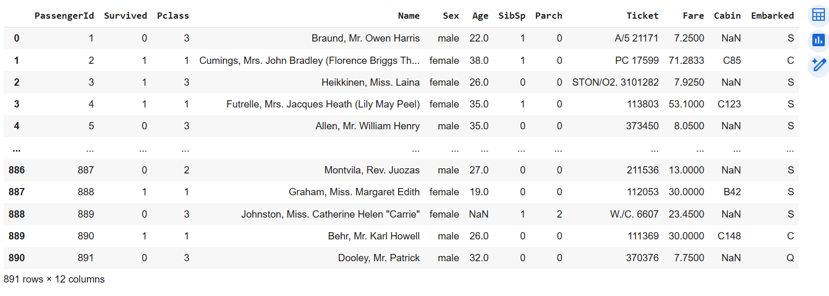

Slide 3
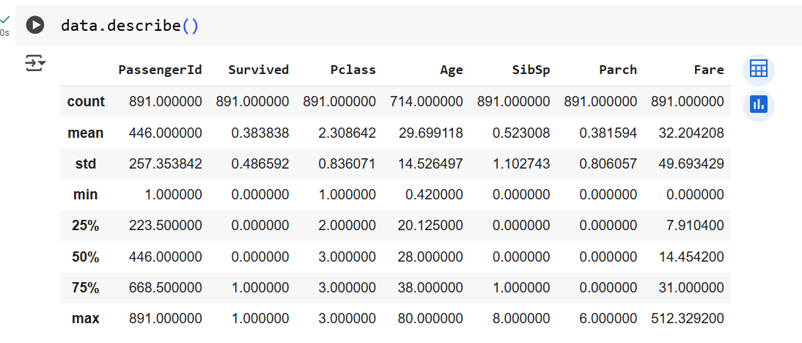

Slide 4
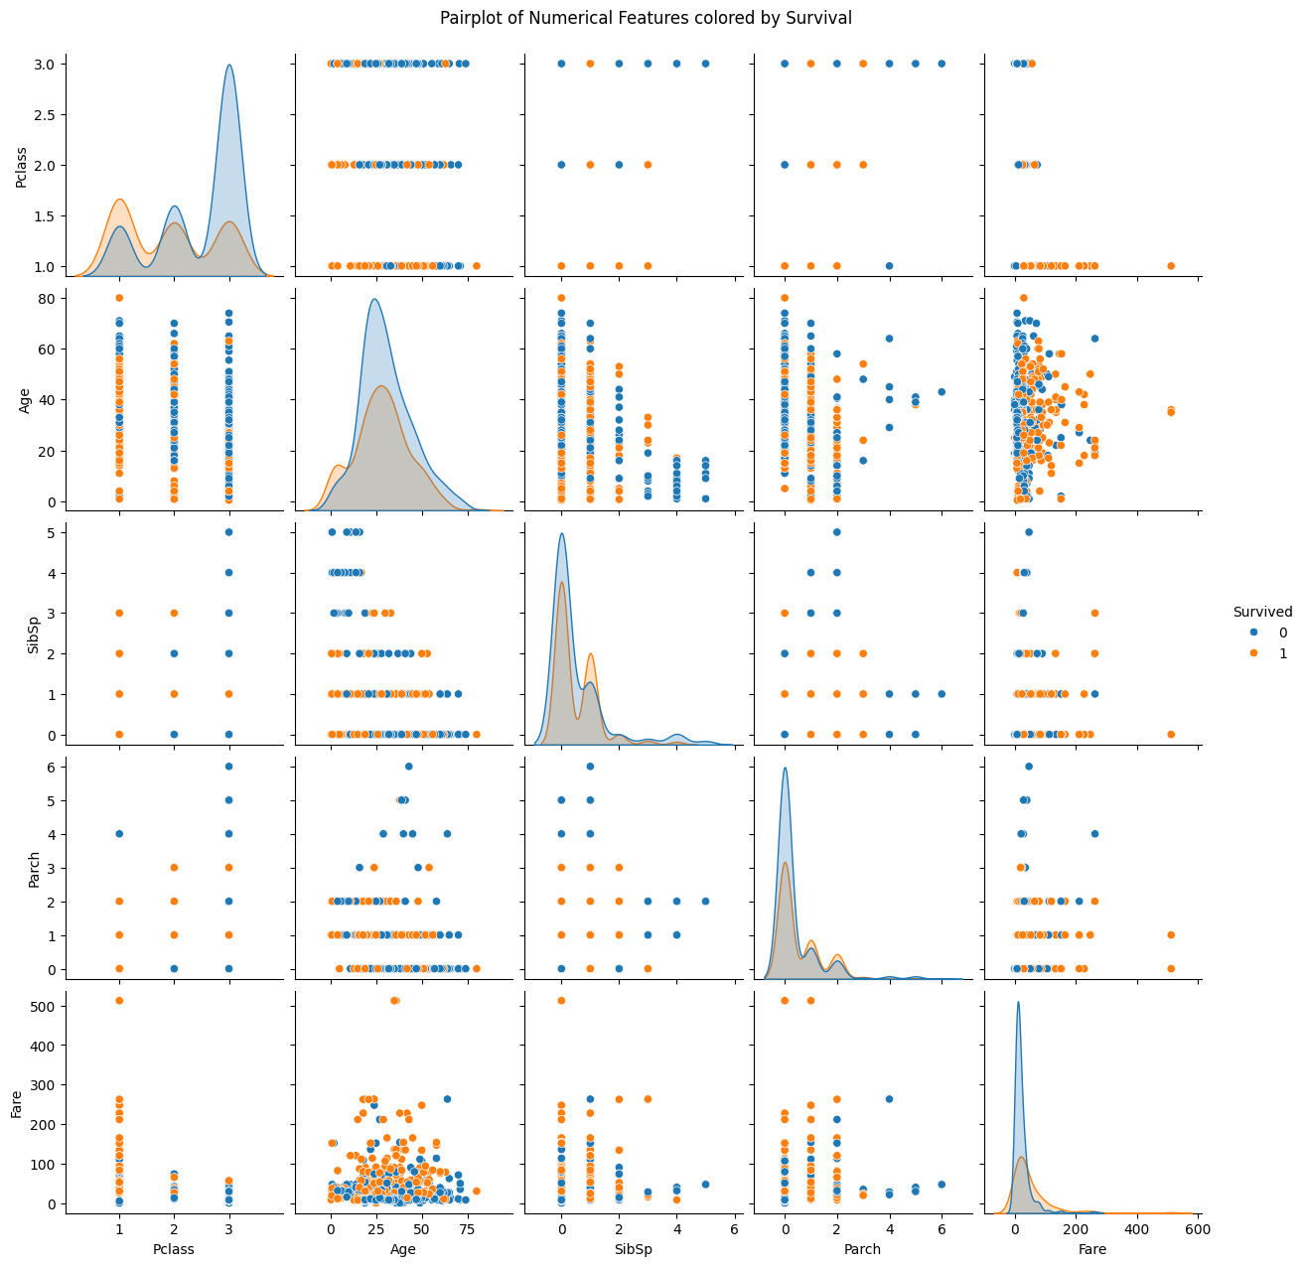
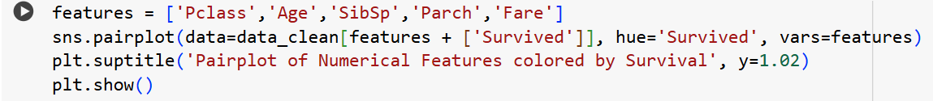
Survivors tend to cluster in lower Pclass, higher Fare.
Children had a better survival rate.

Slide 5
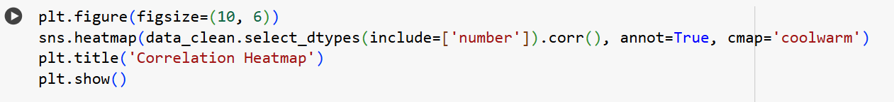
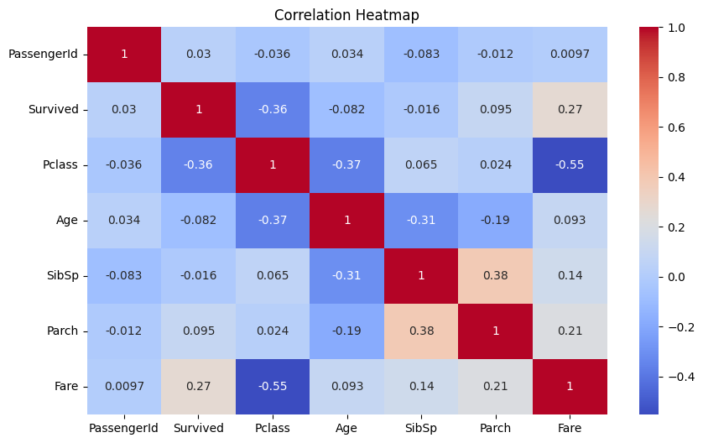
Fare positively correlates with Survived (+0.26).
Pclass negatively correlates with Survived (−0.34).

Slide 6
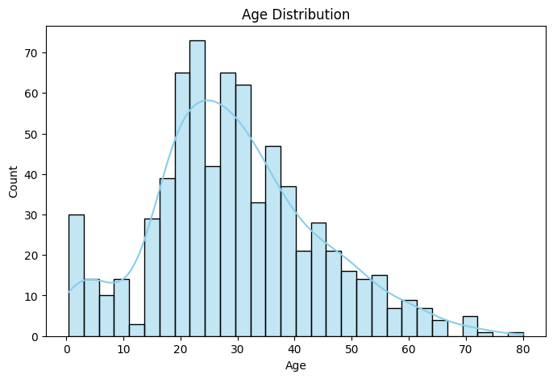
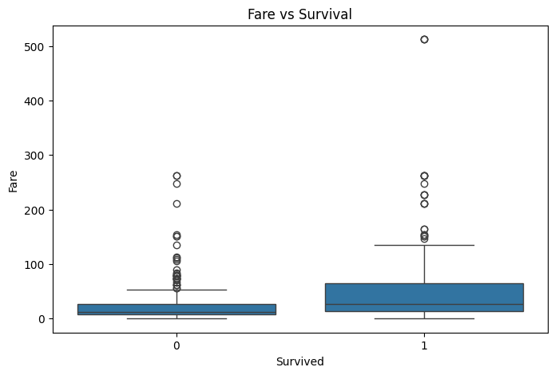
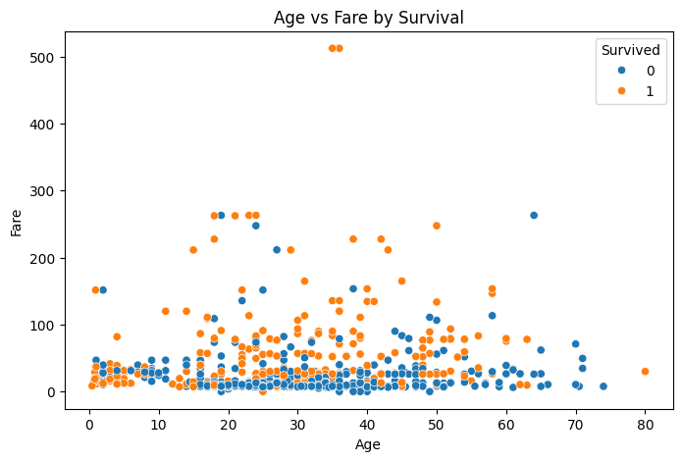
High fare passengers tend to survive.
Young survivors appear in high-fare and low-fare segments.

Slide 7
Observation:
Higher Fare correlates with higher survival.
First class passengers (low Pclass) are more likely to survive.
Most passengers were young adults.
Males had lower survival rate.

